Slide 1
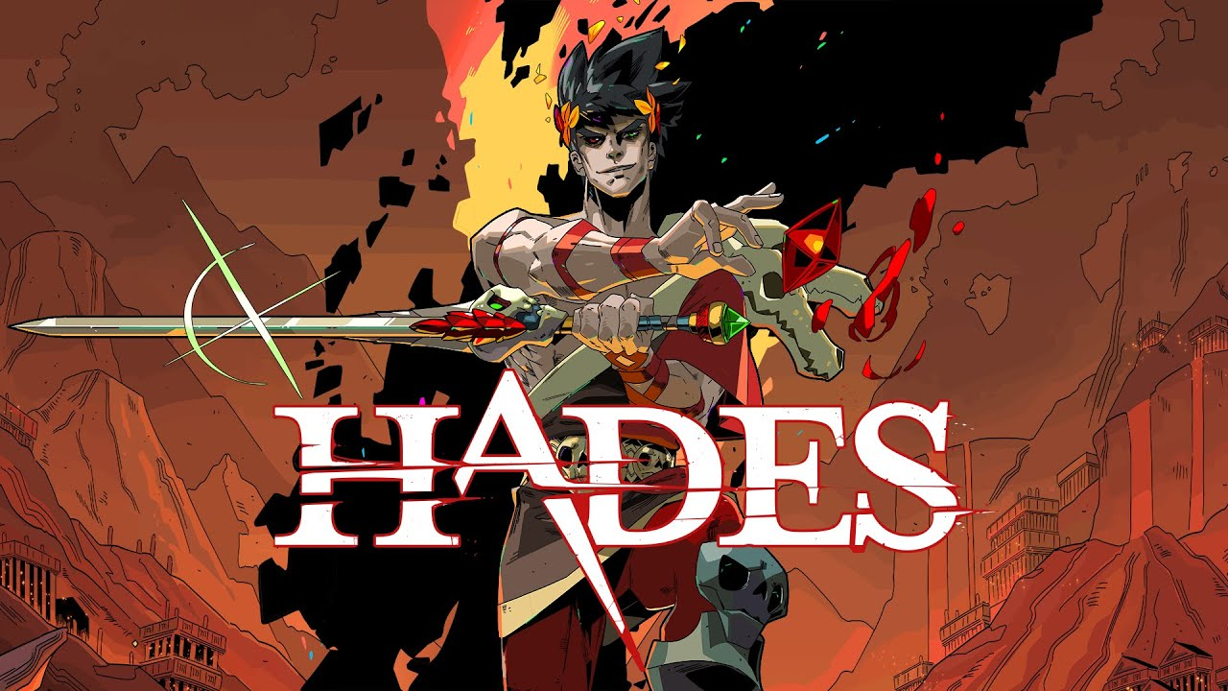

Slide 2
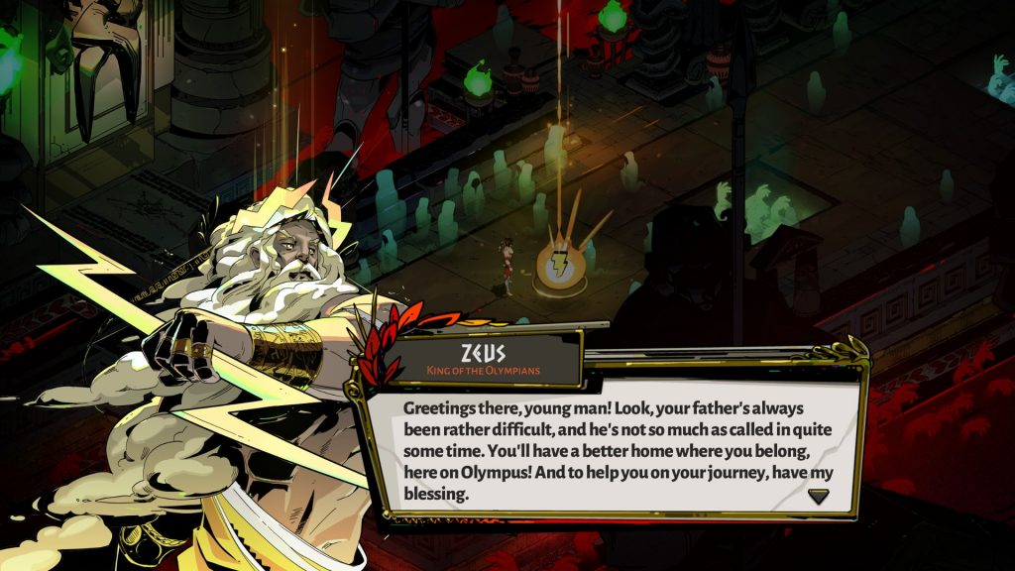
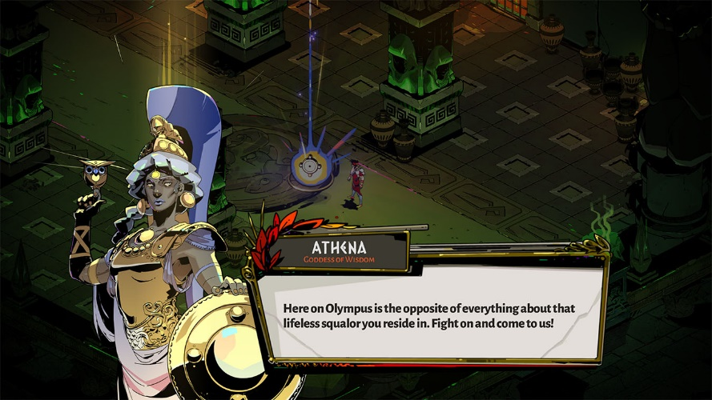
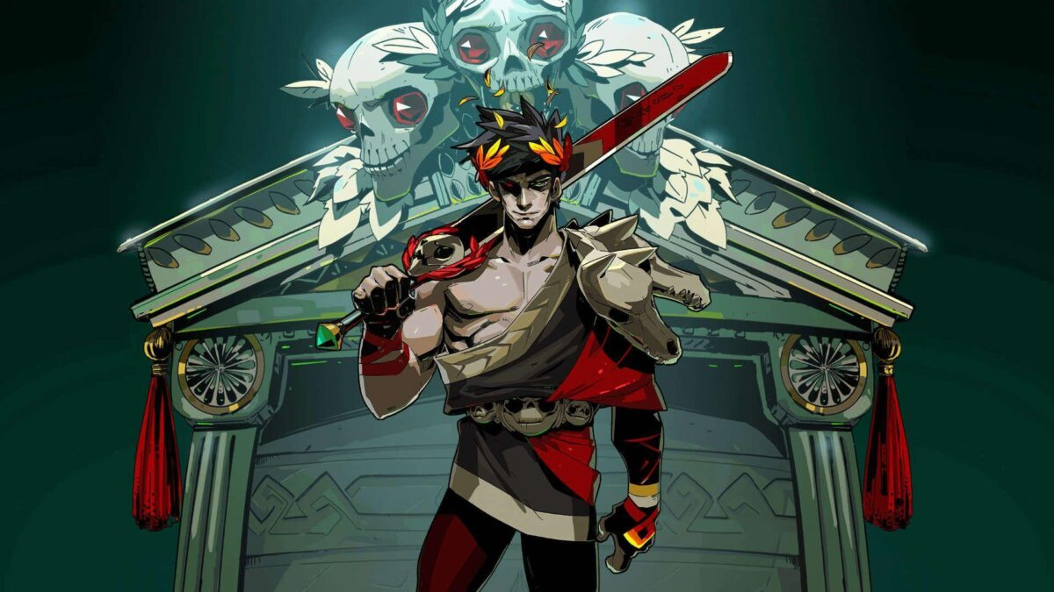
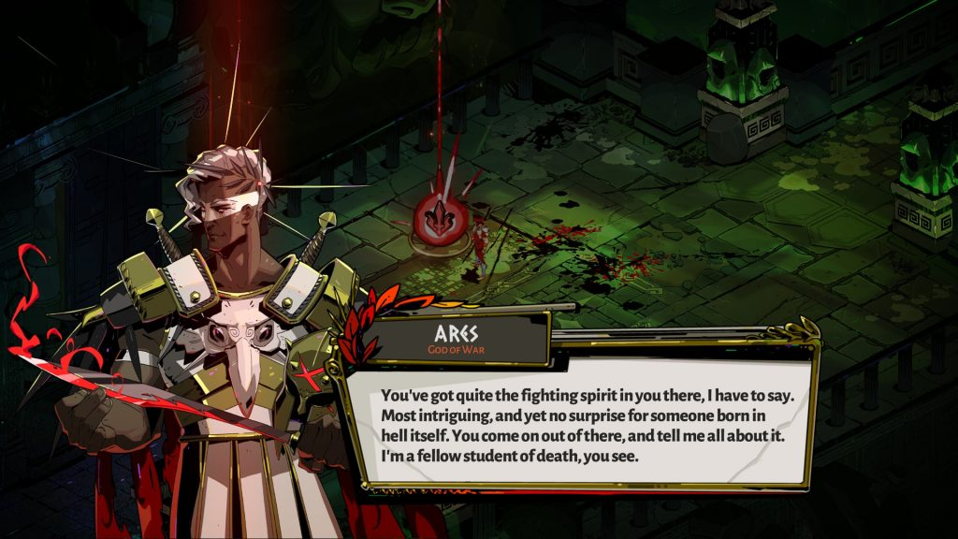
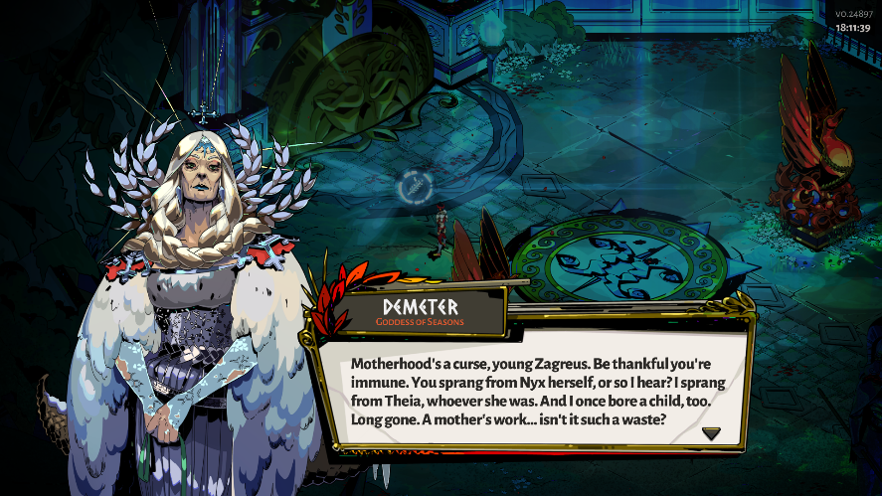

Slide 3
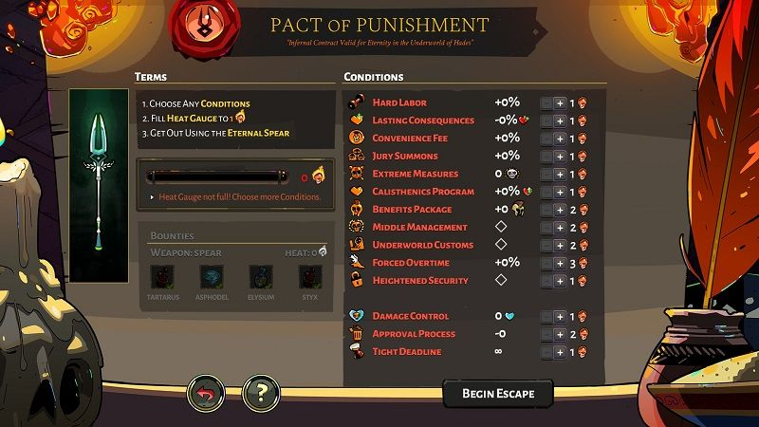
DRAMATİC ELEMTENS
1- Challenge

Slide 4
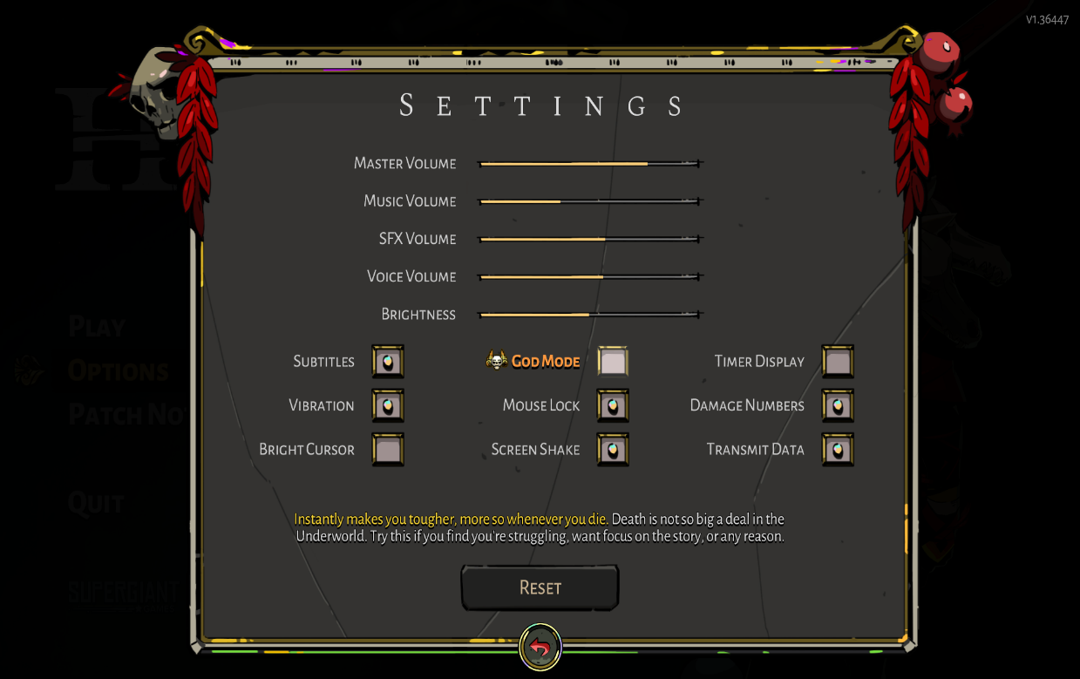
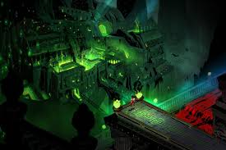
DRAMATİC ELEMTENS
2- Play
3-Premise

Slide 5
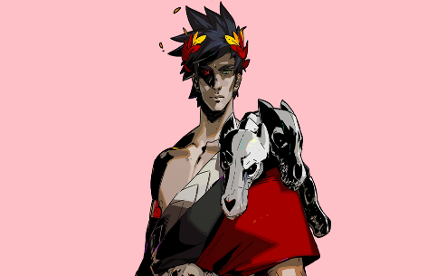
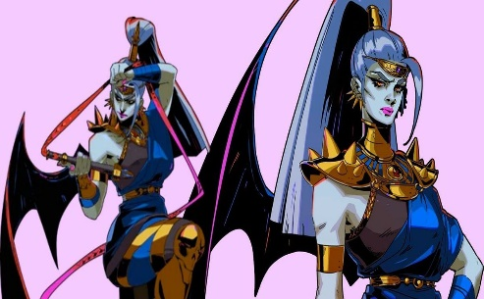
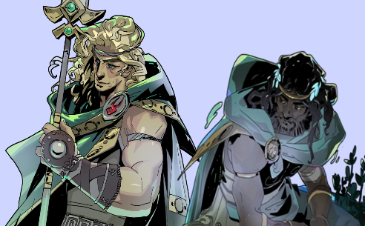
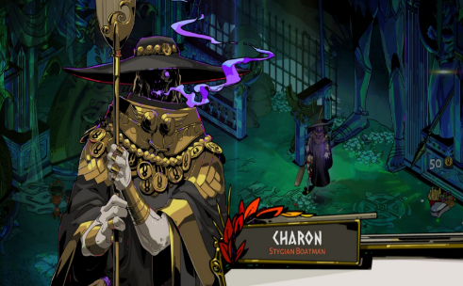
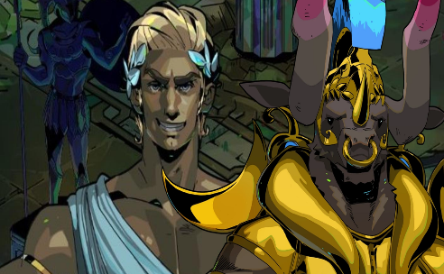
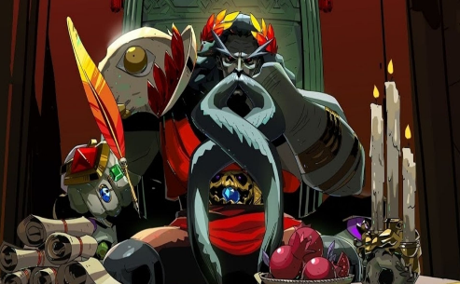
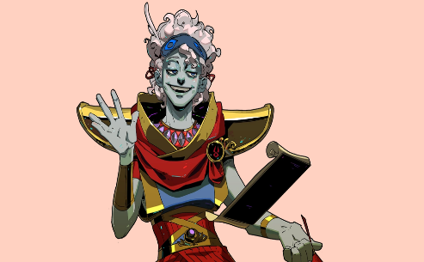
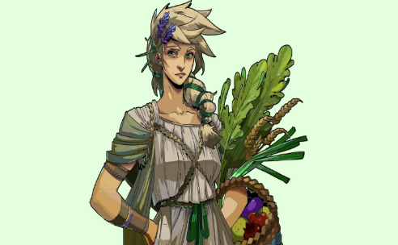
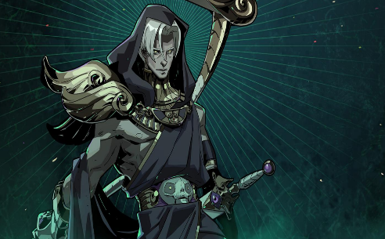
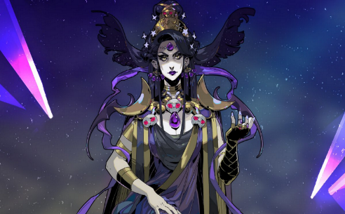
DRAMATİC ELEMTENS
4- Story
5- Character

Slide 6
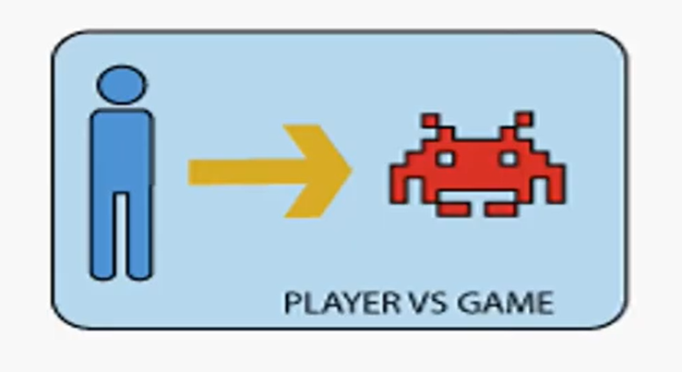
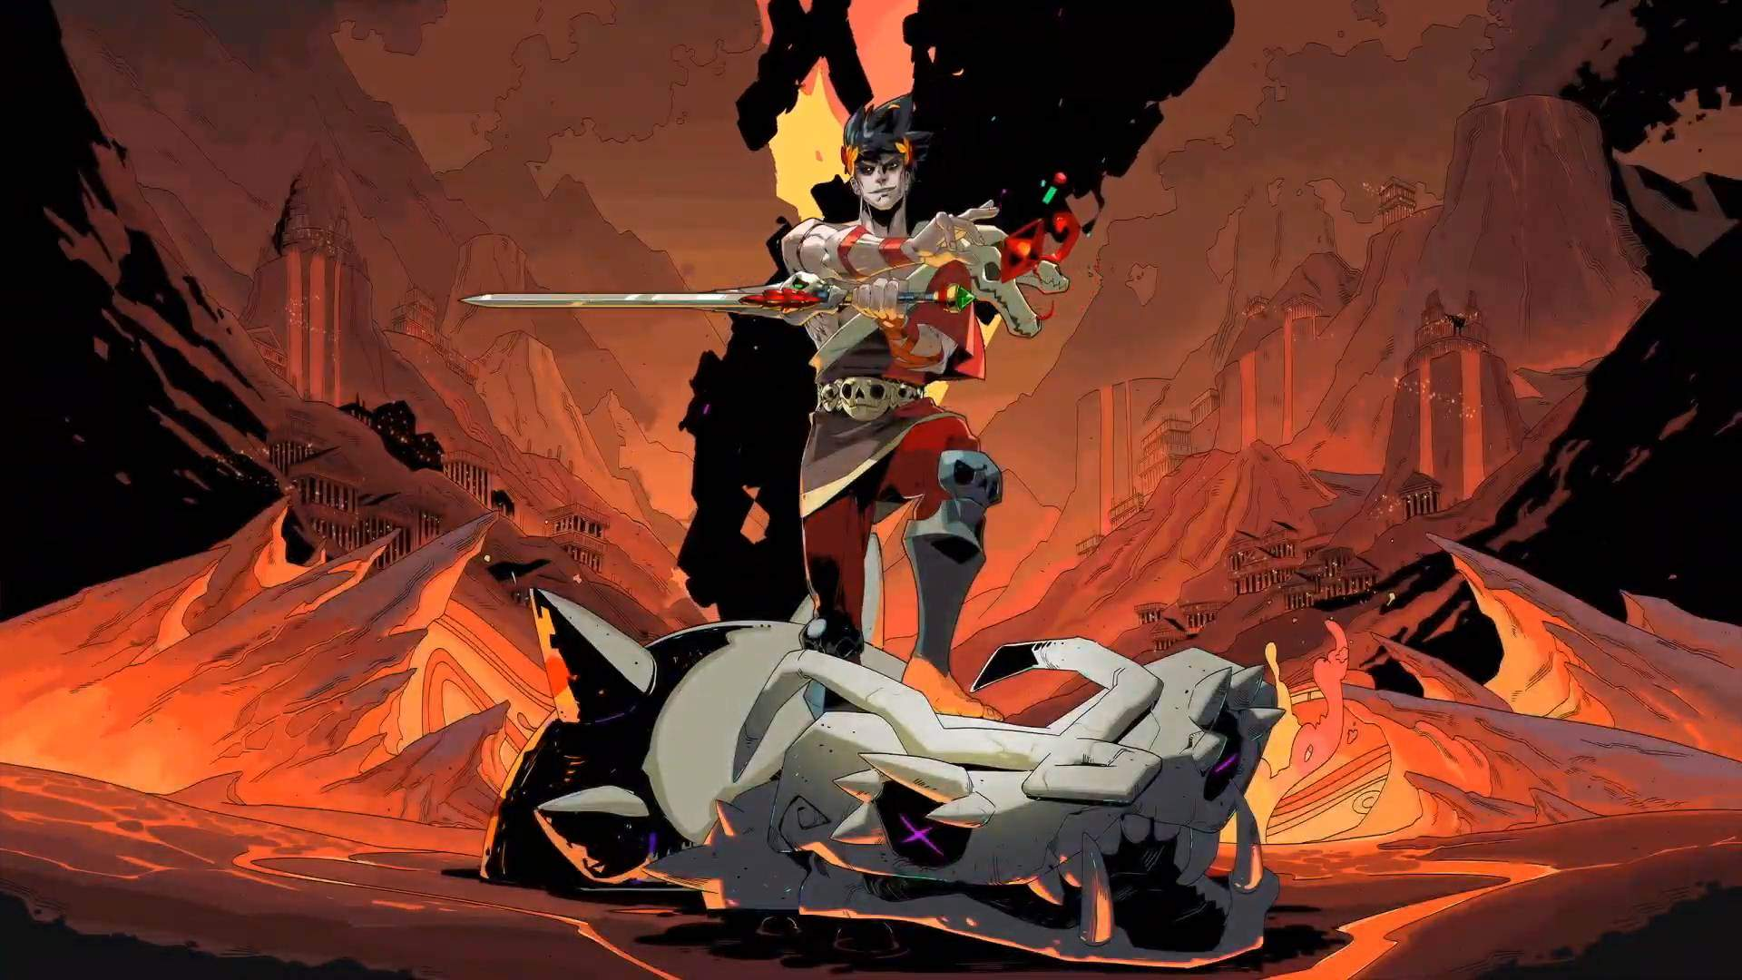
FORMAL ELEMTENS
1- Players
2- Objectives

Slide 7

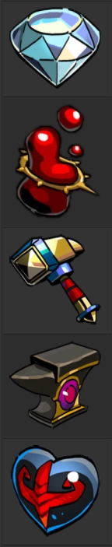

FORMAL ELEMTENS
3-Procedures
4- Rules
5- Resources
Darkness
Diamond
Chthonic Key
Titan Blood
Charon's Obol
Gemstone
Daedalus Hammer
Pom of Power
Nectar
Anvil of Fates
Ambrosia
Centaur Heart

Slide 8
FORMAL ELEMTENS
6- Conflict
7- Boundaries
8- Outcome

Slide 9
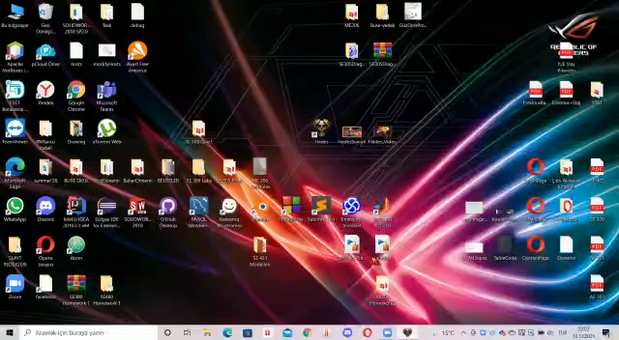

Slide 10
THANK YO FOR LISTENING TO ME!
Name: Buse
Surname: Özel
Number: 20180601032
Department: Software Engineering
Presentation Video Link:
https://youtu.be/_1KnqtUxoiU

